Slide 1
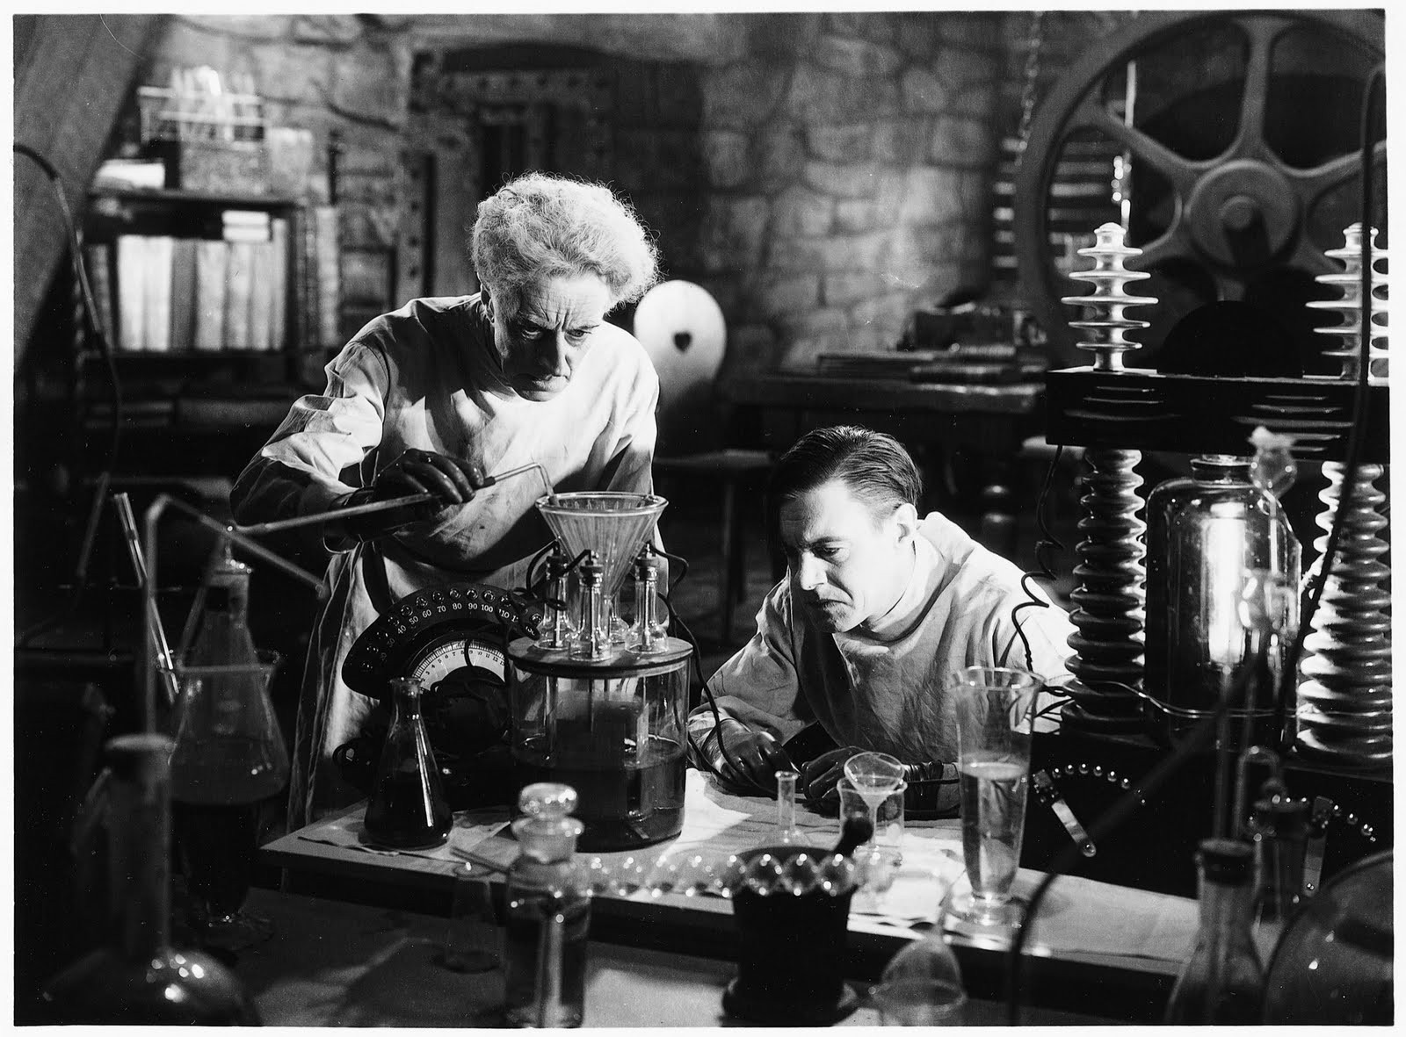
Hypothesis Testing & t-tests

Slide 2
Using Z-tests and One-Sample T-tests
Z-test/one-sample t-test:
Compare sample to known population values
Compare sample score to absolute value
Did my sample score different than _______

Slide 3
Using Paired & Independent Samples T-tests
Always comparison between two sample means. Can be from two sets of individuals or one set that provided two measurements.
Comparing two existing groups (for example, college vs. no college)
Aka: quasi-experimental design
Comparing two manipulated groups
Aka: experimental design

Slide 4

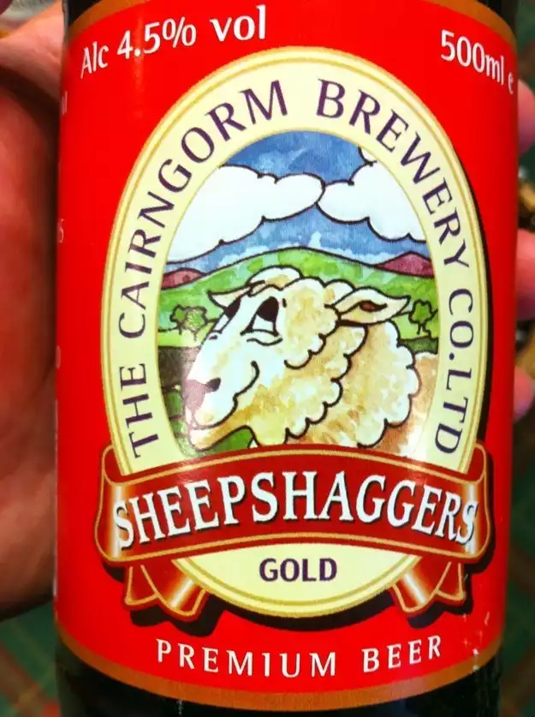
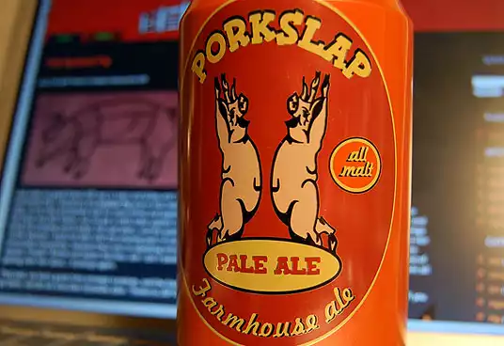


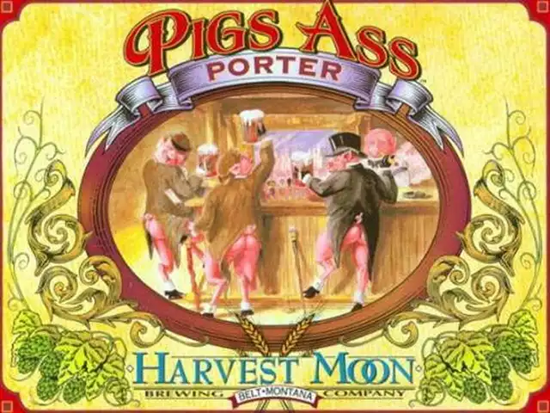

Slide 5
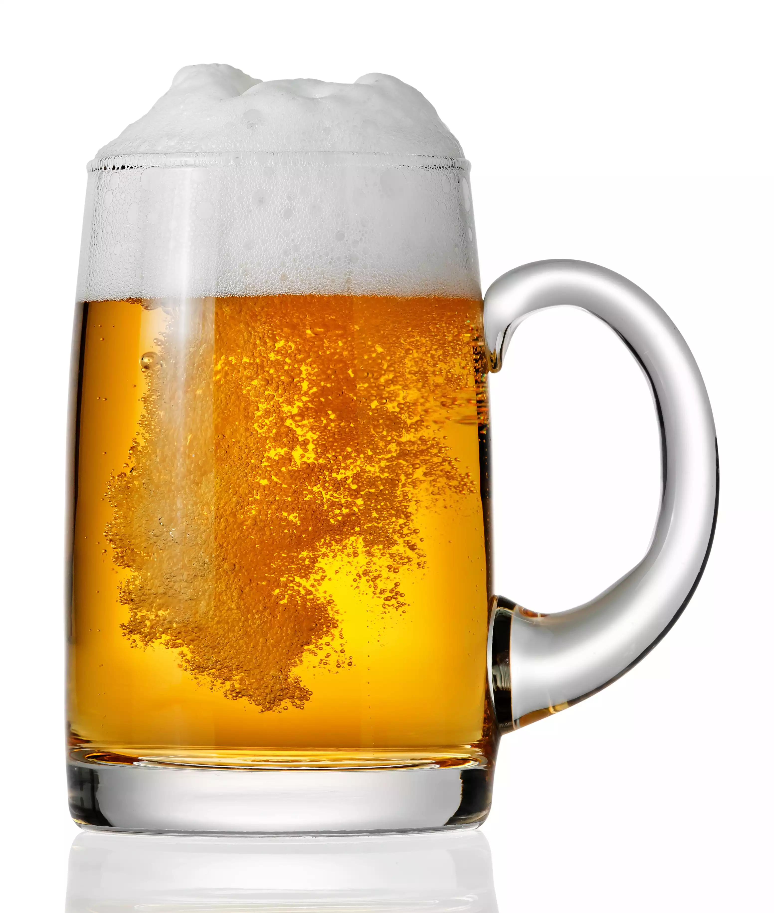

Research Question: Does the name of a beer influence how much people enjoy it?
Specifically:
Do Purchase College students (21+) prefer the taste of a beer called Purchase Brew?
Purchase Brew

Slide 6
Do Purchase students prefer “Purchase Brew”?
Z-test/
One-Sample T-test
Paired-Samples
T-test
Independent Samples
T-test
Imagine the population of Purchase students (of age!) rated a generic beer on a 1-10 scale at Culture Shock last year
Within-Subjects Design
Between-Subjects Design
Recruit a random sample of Purchase students
They complete two tasks: drink and rate the generic beer, and drink and rate the same beer labeled “Purchase Brew.” Order of tasks counterbalanced
Use a paired (related) samples t-test to compare the means
Recruit a random sample of Purchase students
2 Conditions: Randomly assign half to drink and rate the generic beer, half to drink and rate the same beer labeled “Purchase Brew”
Use an independent samples t-test to compare the means
Now we take a sample of students and have them drink and rate the same beer, but we label it “Purchase Brew”
We can use a z-test (if we know σ) r a single (one) sample t-test (if we don’t) to compare the mean ratings
Notes:
We don’t know how students rated the beer before

Slide 7
Steps in Hypothesis Testing
Step 1: Set up hypotheses
Step 2: Compute test statistic
Step 3: Find critical values
Step 4: Compare test statistic to critical value
Step 5: Interpret results

Slide 8
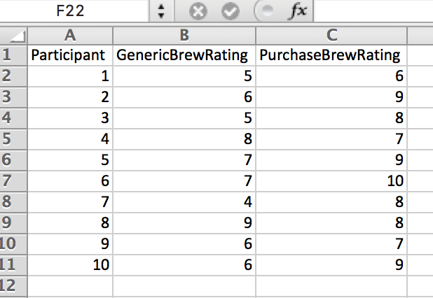
Do Purchase students prefer “Purchase Brew”?
Paired-Samples
T-test
Within-Subjects Design
Recruit a random sample of Purchase students
They complete two tasks: drink and rate the generic beer, and drink and rate the same beer labeled “Purchase Brew.” Order of tasks counterbalanced
Use a paired (related) samples t-test to compare the means
Notes:
We don’t know how students rated the beer before

Slide 9
Do Purchase students prefer “Purchase Brew”?
Paired-Samples
T-test
H₀: μ_{generic} - μ_{PB} = μ_{diff} = 0
H₁: μ_{diff} ≠ 0
Within-Subjects Design
Recruit a random sample of Purchase students
They complete two tasks: drink and rate the generic beer, and drink and rate the same beer labeled “Purchase Brew.” Order of tasks counterbalanced
Use a paired (related) samples t-test to compare the means
df = n – 1
Notes:
We don’t know how students rated the beer before

Slide 10
Do Purchase students prefer “Purchase Brew”?
Paired-Samples
T-test
Difference between the two sample means
(obtained from sample data)
Difference between the two population means
(obtained from H₀)
H₀: μ_{generic} - μ_{PB} = μ_{diff} = 0
H₁: μ_{diff} ≠ 0
Within-Subjects Design
Recruit a random sample of Purchase students
They complete two tasks: drink and rate the generic beer, and drink and rate the same beer labeled “Purchase Brew.” Order of tasks counterbalanced
Use a paired (related) samples t-test to compare the means
Measures the amount of error that is expected when you use a sample mean difference (M₁ – M₂) to predict a population mean difference (μ₁ - μ₂)
The estimated standard error of the difference in means, NOT the standard error of M₁ minus M₂
df = n – 1
Notes:
We don’t know how students rated the beer before

Slide 11
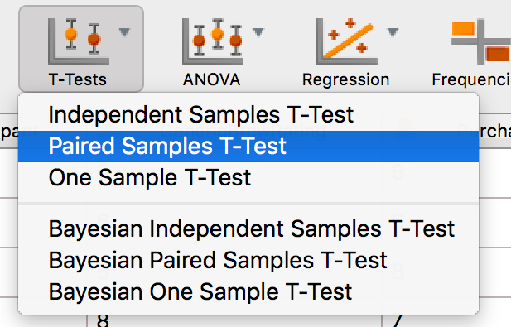
Do Purchase students prefer “Purchase Brew”?
Paired-Samples
T-test
Within-Subjects Design
Recruit a random sample of Purchase students
They complete two tasks: drink and rate the generic beer, and drink and rate the same beer labeled “Purchase Brew.” Order of tasks counterbalanced
Use a paired (related) samples t-test to compare the means
Notes:
We don’t know how students rated the beer before

Slide 12
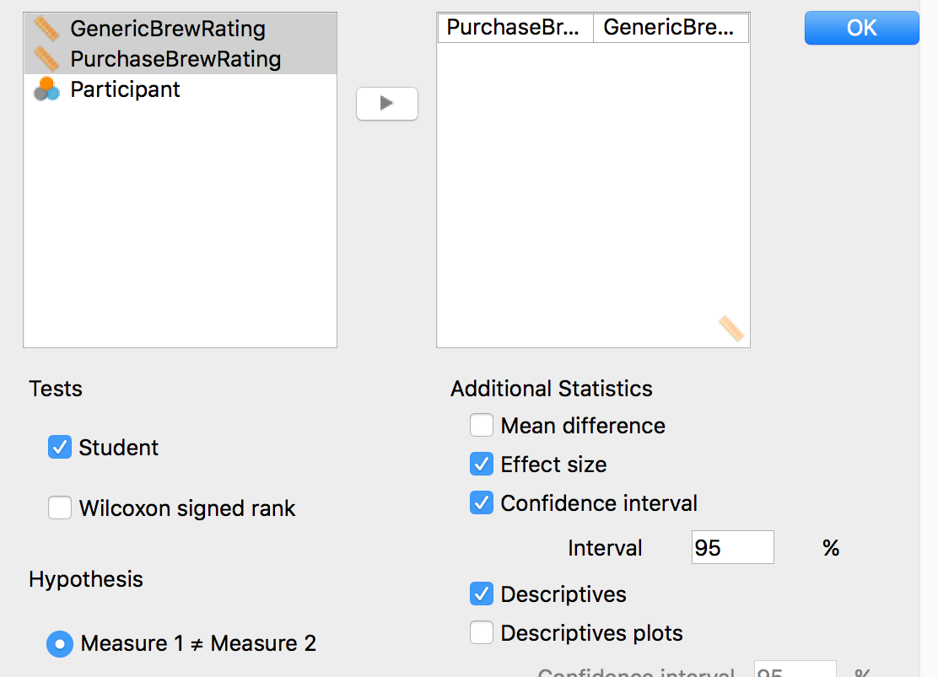
Do Purchase students prefer “Purchase Brew”?
Paired-Samples
T-test
Within-Subjects Design
Recruit a random sample of Purchase students
They complete two tasks: drink and rate the generic beer, and drink and rate the same beer labeled “Purchase Brew.” Order of tasks counterbalanced
Use a paired (related) samples t-test to compare the means
Notes:
We don’t know how students rated the beer before

Slide 13
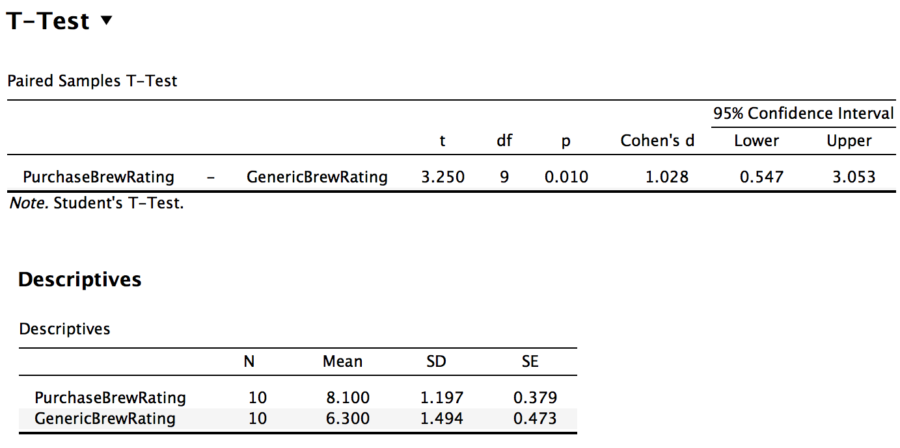
Do Purchase students prefer “Purchase Brew”?
Paired-Samples
T-test
Within-Subjects Design
Recruit a random sample of Purchase students
They complete two tasks: drink and rate the generic beer, and drink and rate the same beer labeled “Purchase Brew.” Order of tasks counterbalanced
Use a paired (related) samples t-test to compare the means
Notes:
We don’t know how students rated the beer before

Slide 14
Do Purchase students prefer “Purchase Brew”?
Paired-Samples
T-test
Within-Subjects Design
Results:
We used a paired-samples t-test to compare participants’ average ratings of the generic beer and the same beer labeled Purchase Brew.
The results revealed that participants gave Purchase Brew significantly higher ratings on average (M = 8.1, SD = 1.2) compared to the unlabeled generic beer (M = 6.3, SD = 1.49), t(9) = 3.25, p = 0.01, d = 1.03, 95% CI [0.55, 3.05].
Recruit a random sample of Purchase students
They complete two tasks: drink and rate the generic beer, and drink and rate the same beer labeled “Purchase Brew.” Order of tasks counterbalanced
Use a paired (related) samples t-test to compare the means
Notes:
We don’t know how students rated the beer before

Slide 15
Independent Samples T-Test

Slide 16
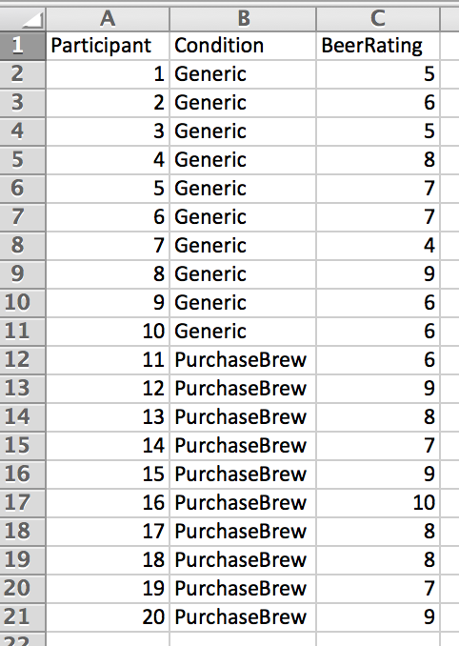
Do Purchase students prefer “Purchase Brew”?
Independent Samples
T-test
Between-Subjects Design
Recruit a random sample of Purchase students
2 Conditions: Randomly assign half to drink and rate the generic beer, half to drink and rate the same beer labeled “Purchase Brew”
Use an independent samples t-test to compare the means
Notes:
We don’t know how students rated the beer before

Slide 17
Do Purchase students prefer “Purchase Brew”?
Independent Samples
T-test
H₀: μ_{generic} = μ_{PB} or μ_{generic} - μ_{PB} = 0
H₁: μ_{generic} ≠ μ_{PB} or μ_{generic} - μ_{PB} ≠ 0
Difference between the two sample means
(obtained from sample data)
Difference between the two population means
(obtained from H₀)
Between-Subjects Design
Recruit a random sample of Purchase students
2 Conditions: Randomly assign half to drink and rate the generic beer, half to drink and rate the same beer labeled “Purchase Brew”
Use an independent samples t-test to compare the means
Measures the amount of error that is expected when you use a sample mean difference (M₁ – M₂) to predict a population mean difference (μ₁ - μ₂)
The estimated standard error of the difference in means, NOT the standard error of M₁ minus M₂
Notes:
As with all hypothesis tests, the general purpose of the independent-measures t test is to determine whether the sample mean difference obtained in a research study indicates a real mean difference between the two populations (or treatments) or whether the obtained difference is simply the result of sampling error.
Remember, if two samples are taken from the same population and are given exactly the same treatment, there will still be some difference between the sample means.
This difference is called sampling error
The hypothesis test provides a standardized, formal procedure for determining whether the mean difference obtained in a research study is significantly greater than can be explained by sampling error
The numerator measures how much difference actually exists between the two sample means, including any difference that is caused by the different treatments.
The denominator measures how much difference should exist between the two sample means if there is no treatment effect that causes them to be different.
A large T is evidence for the existence of a treatment effect.

Slide 18
The t Statistics
 | Single-sample t statistic | Independent-samples t statistic
Formula
Numerator | Actual difference between the sample mean and the hypothesized population mean | Actual difference between the two sample means and the hypothesized difference between the population means
Denominator | Amount of expected error (estimated amount of error expected when we use a sample mean to represent a population mean) | Amount of expected error (estimated amount of error expected when you use a sample mean difference to represent a population mean difference)
Notes:
We are now concerned with the DIFFERENCE between the two sample means – we are looking at that difference and seeing whether it is large enough to determine if the samples come from two different populations or from one same population

Slide 19
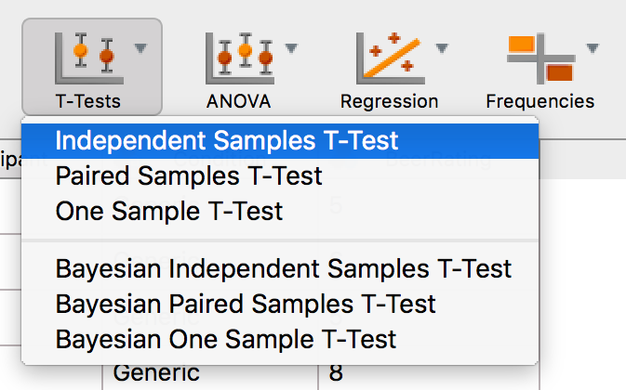
Do Purchase students prefer “Purchase Brew”?
Independent Samples
T-test
Between-Subjects Design
Recruit a random sample of Purchase students
2 Conditions: Randomly assign half to drink and rate the generic beer, half to drink and rate the same beer labeled “Purchase Brew”
Use an independent samples t-test to compare the means
Notes:
We don’t know how students rated the beer before

Slide 20
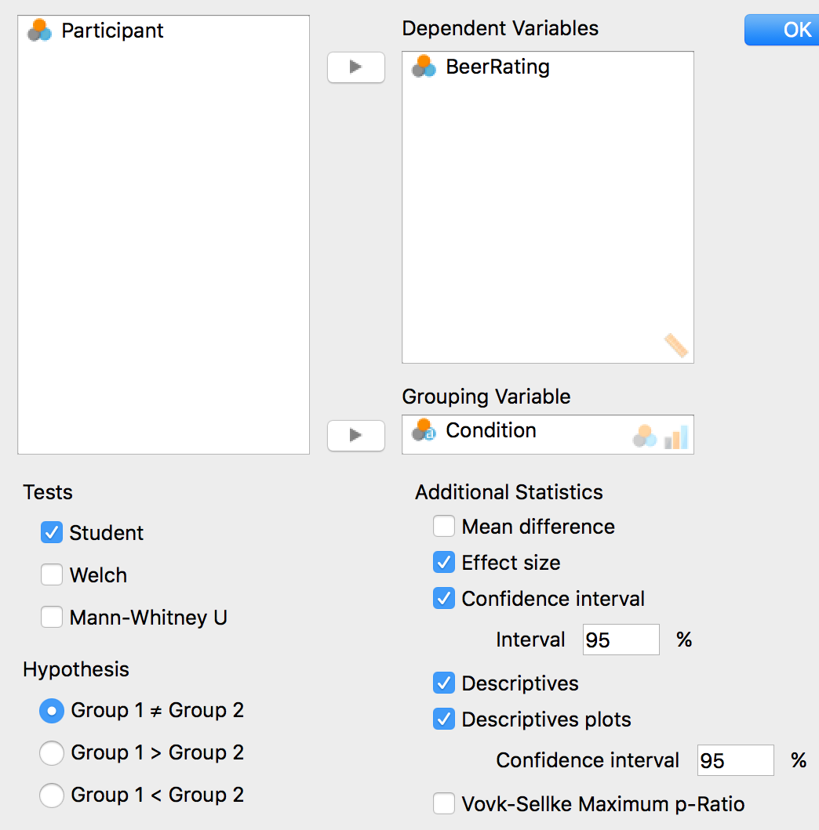
Do Purchase students prefer “Purchase Brew”?
Independent Samples
T-test
Between-Subjects Design
Recruit a random sample of Purchase students
2 Conditions: Randomly assign half to drink and rate the generic beer, half to drink and rate the same beer labeled “Purchase Brew”
Use an independent samples t-test to compare the means
Notes:
We don’t know how students rated the beer before

Slide 21
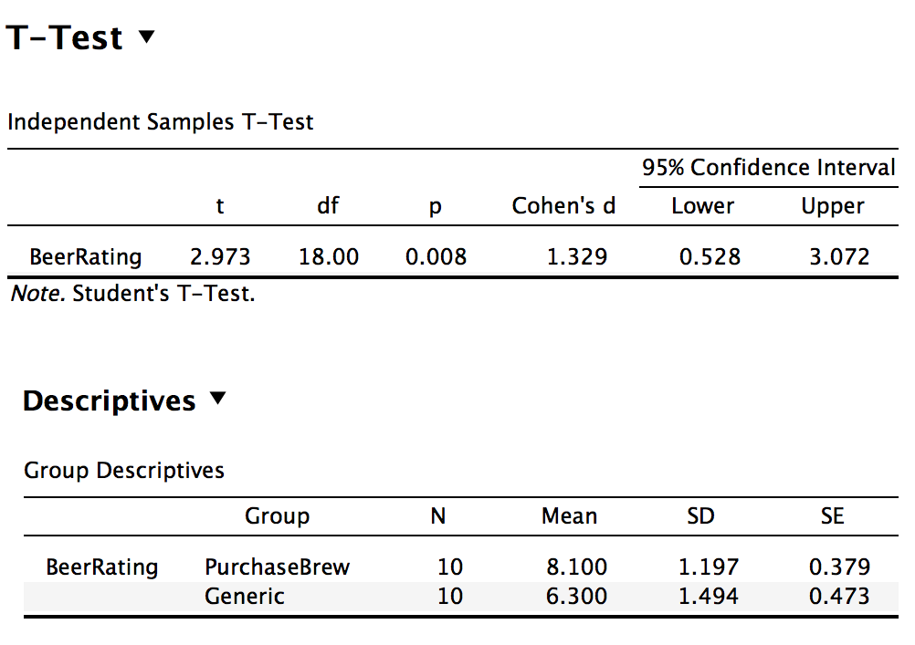
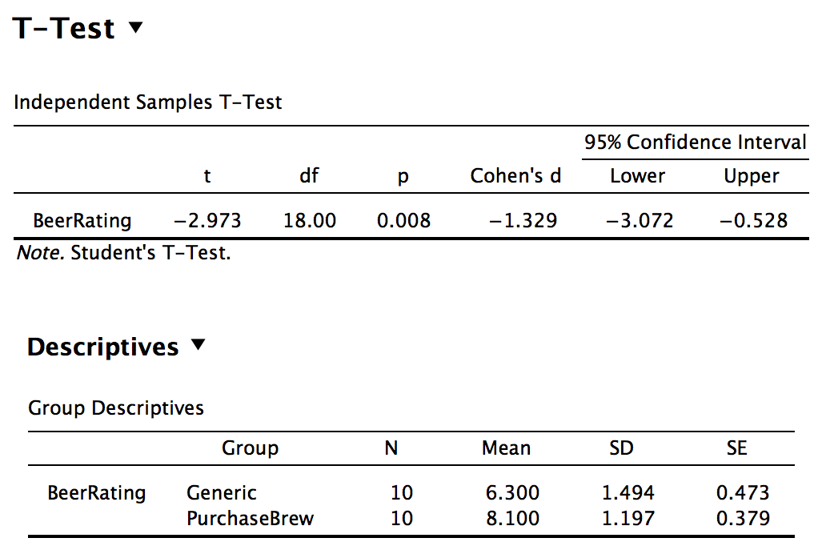
Do Purchase students prefer “Purchase Brew”?
Independent Samples
T-test
Between-Subjects Design
Recruit a random sample of Purchase students
2 Conditions: Randomly assign half to drink and rate the generic beer, half to drink and rate the same beer labeled “Purchase Brew”
Use an independent samples t-test to compare the means
Notes:
We don’t know how students rated the beer before

Slide 22
Do Purchase students prefer “Purchase Brew”?
Independent Samples
T-test
Results:
We used an independent-samples t-test to compare the average beer ratings of participants in the generic beer condition to average beer ratings of participants in the Purchase Brew condition.
The results revealed that participants who drank the beer labeled Purchase Brew gave significantly higher ratings on average (M = 8.1, SD = 1.2) compared to those who drank the unlabeled, generic beer (M = 6.3, SD = 1.49), t(18) = 2.97, p = 0.008, d = 1.33, 95% CI [0.53, 3.07].
Between-Subjects Design
Recruit a random sample of Purchase students
2 Conditions: Randomly assign half to drink and rate the generic beer, half to drink and rate the same beer labeled “Purchase Brew”
Use an independent samples t-test to compare the means
Notes:
We don’t know how students rated the beer before

Slide 23
Assumptions that should be satisfied
The observations within each sample must be independent
The two populations from which the samples are selected must be normal (or your samples should be large)
Homogeneity of variance: The two populations from which the samples are selected must have equal variances
Notes:
The first two assumptions are the same as the assumptions for the single-sample t-test we discussed in Chapter 9.
Requires that the two populations from which the samples are obtained have equal variances
Pooled variance only makes sense if we are averaging two values measuring similarly shaped populations
If this assumption is violated, then the t statistic contains two questionable values:
the value for the population mean difference (which comes from H₀)
the value for the pooled variance
We cannot determine which of these two values is responsible for a t that falls into the critical region
You cannot be certain that rejecting H₀ is correct when you obtain an extreme value for t
Requires that the two populations from which the samples are obtained have equal variances
Pooled variance only makes sense if we are averaging two values measuring similarly shaped populations
If this assumption is violated, then the t statistic contains two questionable values:
the value for the population mean difference (which comes from H₀)
the value for the pooled variance
We cannot determine which of these two values is responsible for a t that falls into the critical region
You cannot be certain that rejecting H₀ is correct when you obtain an extreme value for t

Slide 24
Remember:
We use inferential statistics to draw inferences about the larger population from which our samples were drawn (e.g., all undergraduate students)
If we sample the members of a population randomly, we can assume that the sample represents the population it came from fairly well.
More specifically, the mean and standard deviation of the sample should closely approximate the mean and standard deviation of the entire population.

Slide 25
So we are essentially comparing measures of central tendency
Inferential Statistics

Slide 26
comparing means cheat sheet
Type of Test | When to use | Test Statistic | df | Variance | SE
Single-sample z-Test | Sample M vs known μ; σ is known (or n is large) |  | n/a | given
Single-sample t-Test | Sample M vs known μ; σ is unknown (& n is small) |  | n-1
Independent-samples t-Test | Comparing two sample means when unrelated |  | (n₁-1) +(n₂-1)
Paired (related) -samples t-Test | Comparing two sample means when related |  | n-1

Slide 27
We are comparing two sample distributions to each other to see if they are actually two separate distributions, or if they are actually the same.

Slide 28
Inferential Statistics: The Basic Logic
So if we know the mean and standard deviation of the sample, we infer what the population looks like.

Slide 29
Hypothetical Population of All Laptop Users
52
Frequency
10 20 30 40 50 60 70 80 90 100
Notes:
JAMES: Explain what this bell curve really means. If we randomly sampled this population thousands of times and calculated the mean and s.d. of all those samples, they would be a little different each time, but MOST of the means would fall toward whatever the true population mean was, resulting in a bell curve

Slide 30
Inferential Statistics: The Basic Logic
We use this basic logic to compare the mean and standard deviation of two samples (e.g., laptop users, and laptop non-users) and decide whether the difference between them is LIKELY (or probably) just due to random chance.

Slide 31

To answer the question of whether laptop use influences test scores, we need to know:
Are these 40 scores more accurately thought of as just two samples drawn from one population (all students) with a mean of 56.6?
Or from two populations (laptop-users and non-users) with two different means (52.0 and 63.0)?

Slide 32
Comparing two means
One possible world:
laptops have no (null) effect
Two samples, but one population mean
This difference just due to chance
Mean
1
Mean
2
H₀ : The “Null Hypothesis”
Notes:
JAMES--it may be helpful to explain to them that with random sampling, just by chance you are likely to get get two groups with different means. Imagine randomly taking 10 people from the class and asking them their shoe size. It is very unlikely that you will get EXACTLY the same mean shoe size for the two groups, just by chance. So what we are trying to figure out is whether the difference we get is just due to chance, or whether there is something else, more meaningful going on.

Slide 33
56.6
52.0
63.0
Frequency
10 20 30 40 50 60 70 80 90 100
Notes:
Sample hundreds more….actual population is normal curve

Slide 34
Scores from Both Samples
Or from two populations (laptop-users and non-users) with two different means (52.0 and 63.0)?
Frequency
10 20 30 40 50 60 70 80 90 100

Slide 35
Comparing two means
Another possible world:
laptops affect grades
Two populations with two different means
This difference unlikely just due to chance
Mean
1
Mean
2
H₁ : The “Alternative Hypothesis”

Slide 36
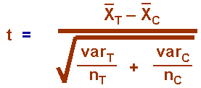
Inferential Statistics
Comparing two means with a t-test
The null hypothesis (H₀)
The alternate hypothesis (H₁)

Slide 37
Significance testing
Inferential Statistics
The null hypothesis (H₀)
The alternative hypothesis (H₁)
Statistical tests (e.g., a “t-test”) compute the probability that we would observe this big of a difference between the groups if the H₀ is true (just by chance).
➔ The ‘p value’
If p is low enough (often p<.05), we can reject H₀ as unlikely and adopt instead the alternative hypothesis.

Slide 38
Statistical result:
Groups are different, p<.05.
52.0
63.0
Laptop Users
Laptop Non-users
X
Mean Exam Score
0 10 20 30 40 50 60 70 80 90 100
Conclusion: laptop use does influence test scores.

Slide 39
Which test to use?
Taylor and Ste-Marie (2001) studied eating disorders in 41 Canadian female figure skaters. They compared the figure skaters’ data on the Eating Disorder Inventory to the means of known populations, including women with eating disorders. On average, the figure skaters were more similar to the population of women with eating disorders than to the population of women without eating disorders.
Notes:
Single sample t-test / z-test

Slide 40
Which test to use?
In an article title “A fair and Balanced Look at the News: What Affects Memory for Controversial Arguments,” Wiley (2005) found that people with a high level of previous knowledge about a given controversial topic (e.g., abortion, military intervention) had better average recall for arguments on both sides of that issue than did those with lower levels of knowledge.
Notes:
Independent samples t-test

Slide 41
Which test to use?
Engle-Friedman and colleagues (2003) studied the effects of sleep deprivation. Fifty students were assigned to one night of sleep loss (students were required to call the laboratory every half-hour all night) and then one night of no sleep loss (normal sleep). The next day, students were offered a choice of math problems with differing levels of difficulty. Following sleep loss, students tended to choose less challenging problems.
Notes:
Paired samples t-test

Slide 42
Which statistical test(s) to run?
Independent Variable | Dependent Variable
 |  | Continuous | Categorical
 | Continuous | correlation regression | logistic regression
 | Categorical | z-Test t-Test ANOVA | chi-square binomial test

Slide 43
Measuring Effect Size
We don’t know this
so we use this
0.0 < d < 0.2 = Small effect size
0.2 < d < 0.8 = Medium effect size
d > 0.8 = Large effect size

Slide 44
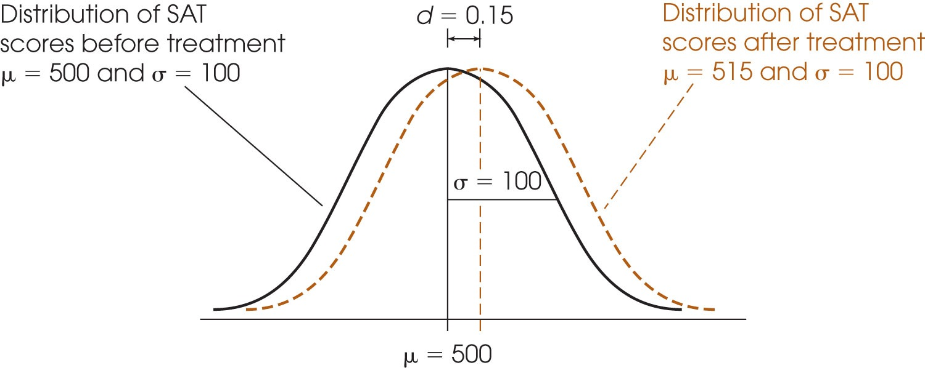
Cohen’s d uses σ to measure effect size

Slide 45
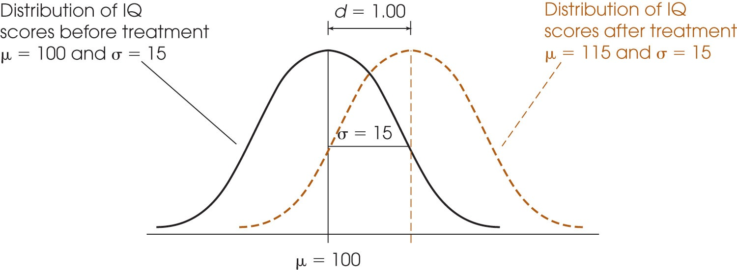
Cohen’s d uses σ to measure effect size
Notes:
Cohen’s d gives us effect size in terms of standard deviation. a d of 1.00 means the treatment changed the mean by 1 standard deviation.

Slide 46
